Slide 1
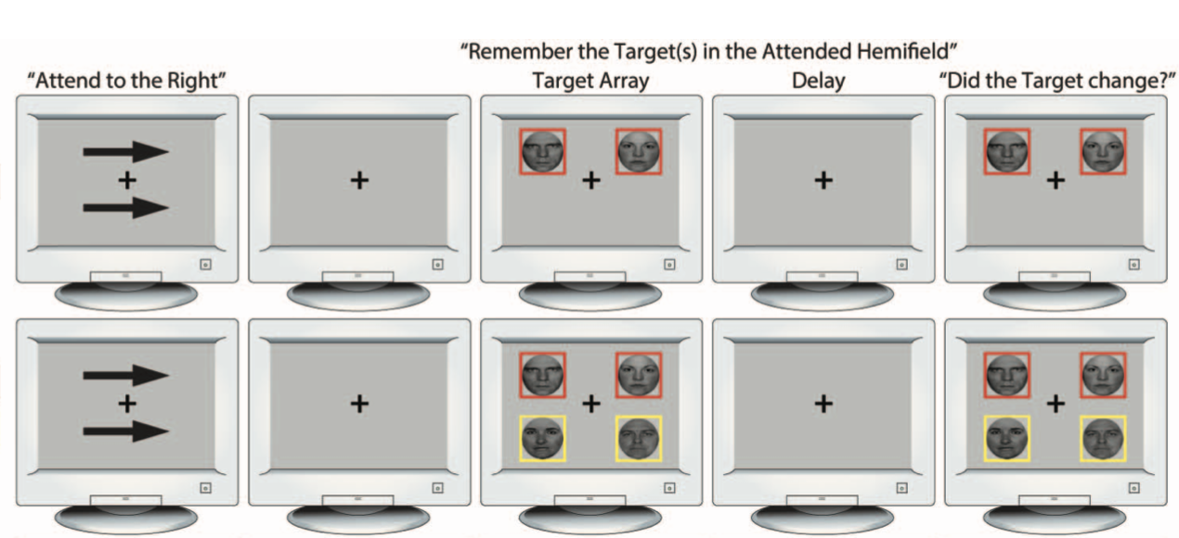
A quick demo!
Instructions:
Maintain fixation throughout the trial.
Memorize only the image displayed on the side indicated by the arrow cues (left or right side of the screen) and framed in red.
Image displayed on the opposite side and framed in yellow has no importance for the response.
Your task is to decide whether the image you memorized had changed or not.
See an example below:

Slide 2
+

Slide 3
+

Slide 4
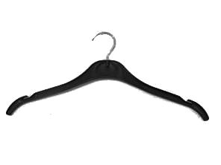
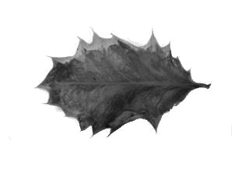
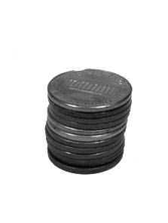
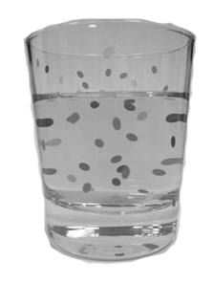
+

Slide 5
+

Slide 6
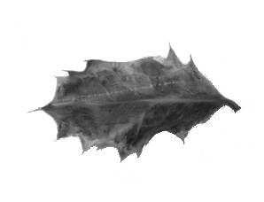
+

Slide 7
+

Slide 8
+

Slide 9
+

Slide 10
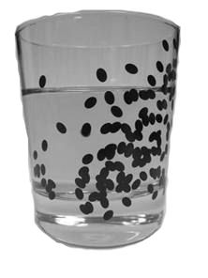
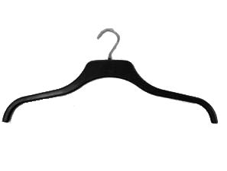
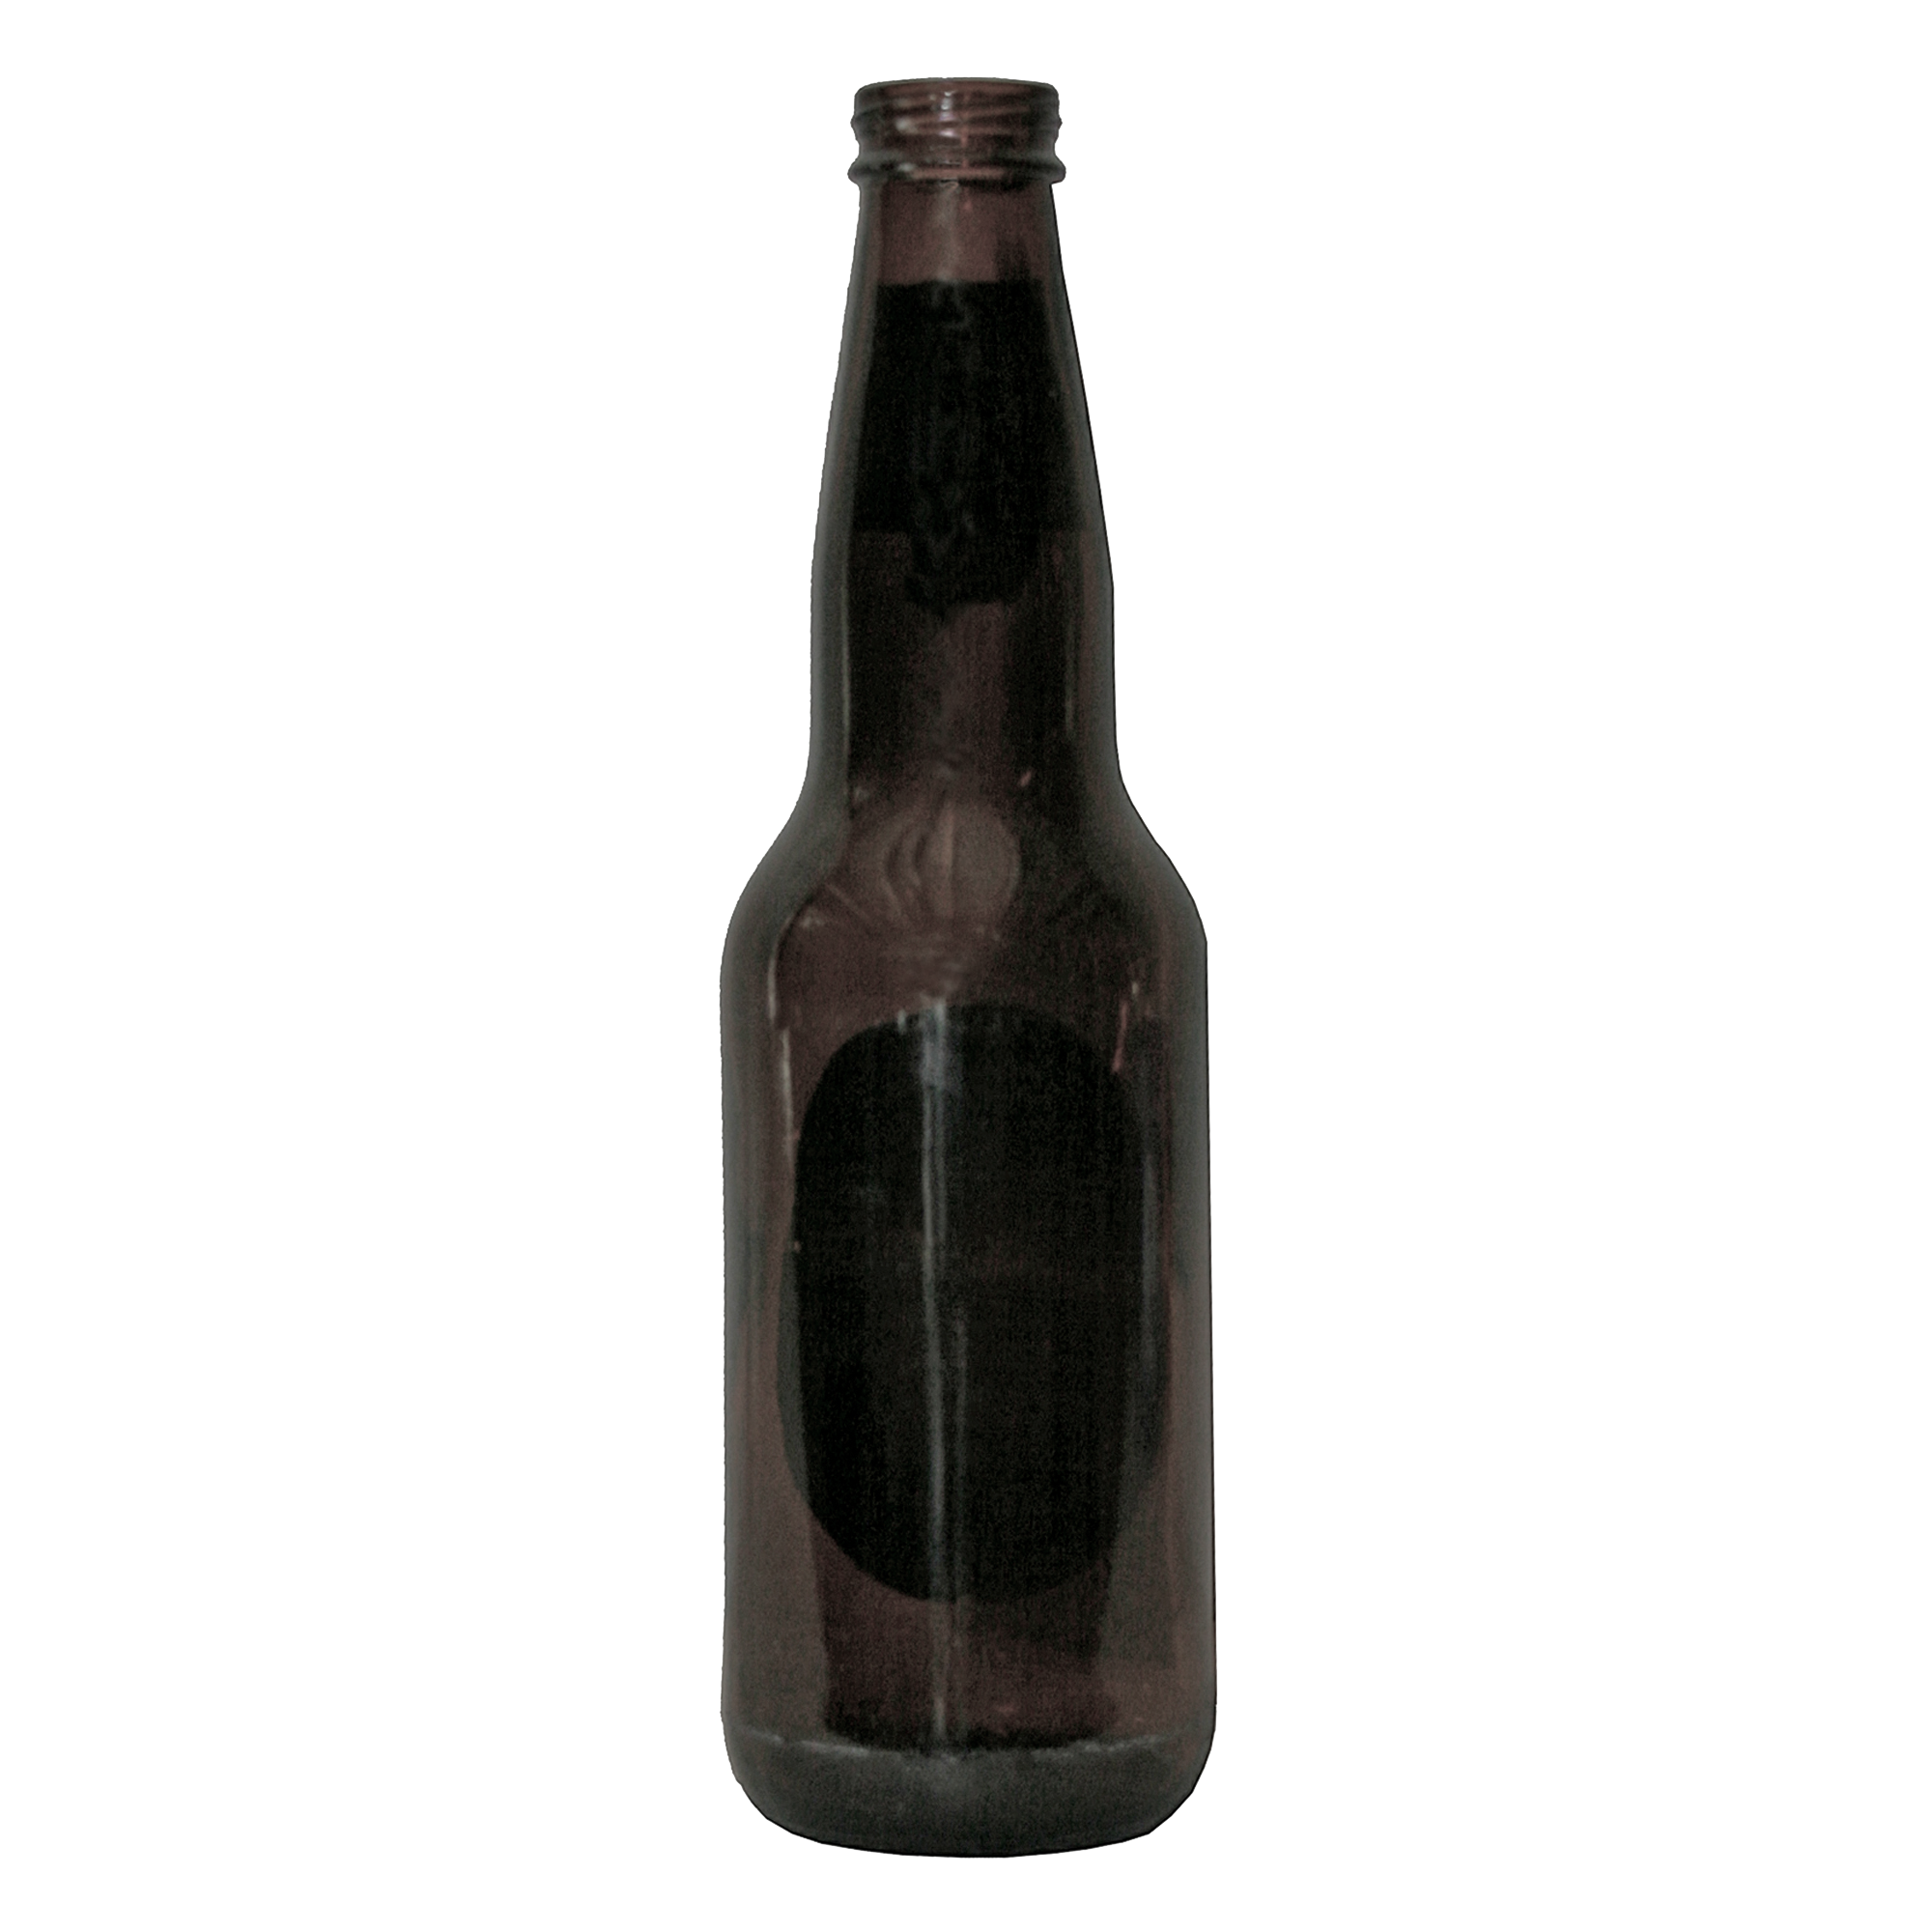
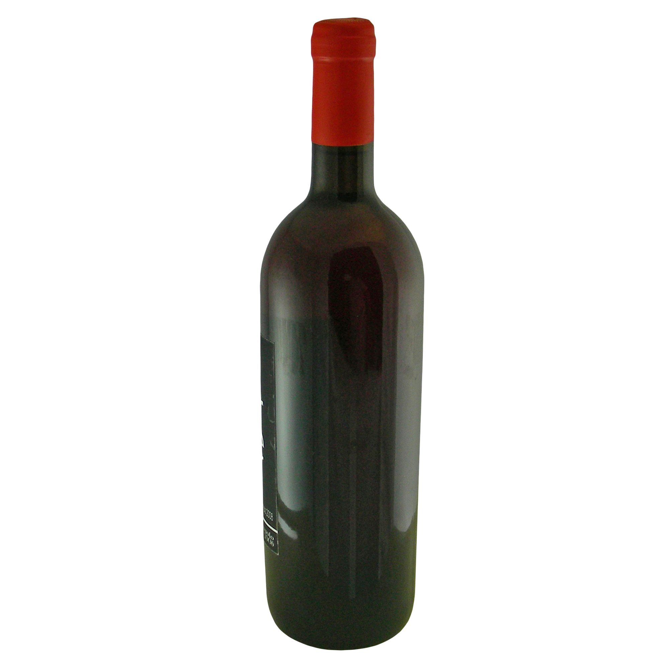
+

Slide 11
+

Slide 12
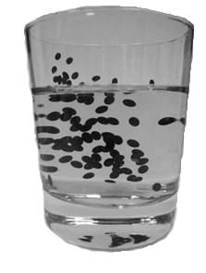
+

Slide 13
+

Slide 14
Things to consider for stimuli selection:
The original study used face stimuli: “The stimuli were grayscale digital photographs of upright faces of 12 individuals (7 females and 5 males) with a neutral (12 photographs) and a fearful (12 photographs) expression selected from Ekman and Friesen’s (1976) and Lundqvist, Flykt, and O¨hman’s (1998) databases.”
Neutral target stimuli matched the probe 50% of the time, and did not match the probe the rest of the time. That means, we need neutral target stimuli that are similar enough to one another but not exactly the same.
That means, we need 12 neutral images (that have similar pairings), 12 alcoholic images (that don’t necessarily need to have a match) (attached zip folder contains my finds based on info below)
Some images can be selected from the BOSS normed stimulus dataset. https://sites.google.com/site/bosstimuli/download or https://drive.google.com/open?id=1FpnEFkbqe_huRwfsCf7gs5R1zuc1ZOkn Here, they have beer and wine pictures for example. These items are matched based on their familiarity.
However since we are not using face stimuli, we also need a database of objects with normed similarity indexes so that we can make sure the non-match neutral target stimuli are not explicitly different from the probe.
Here is an article that calculated similarity indexes for variety of neutral images: https://link.springer.com/article/10.3758/s13428-012-0255-4#SecESM1
According to this table Holly, Hanger, Coins, Glass have the highest similarity, so I can use those four as neutral stimuli. https://link.springer.com/article/10.3758/s13428-012-0255-4/tables/1
The excel sheets at the end of the article page gives itemized similarity between items.

Slide 15
+

Slide 17
+

Slide 18
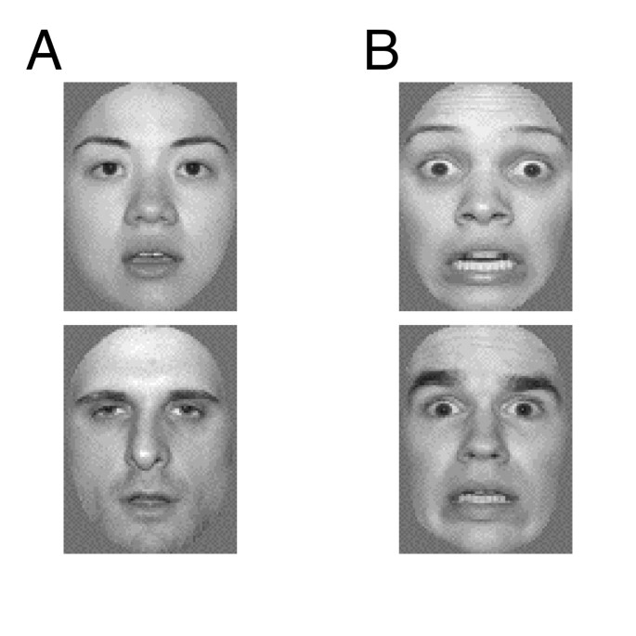
+

Slide 19
+

Slide 20
+

